Slide 1
Compile-time errors

Slide 2
Outline
In this lesson, we will:
  Define compile-time errors
  Look at many different examples where mistakes in coding result in compile-time errors

Slide 3
Compile-time errors
Sometimes, in English, you can say something wrong, but the person listening to you will understand what you meant
  If you’re unlucky, they’ll misunderstand you…
The compiler is not so forgiving: if you enter C++ code that does not make sense within the C++ programming language, the compiler will simply tell you
  Fortunately, it often tries to help you understand what it is confused about
  It will never make assumptions about what you meant; after all, if it “guessed wrong”, you may have the firmware on your pacemaker product malfunctioning with rather catastrophic consequences

Slide 4
Compile-time errors
We will take working code, and introduce errors to see how the compiler responds:
    #include <iostream>
    // Function declarations
    int main();
    double my_sin( double x );
    // Function definitions
    int main() {
    std::cout << "Hello world!" << std::endl;
    std::cout << "sin(0.5) = " << my_sin(0.5) << "!" << std::endl;
    return 0;
    }
    double my_sin( double x ) {
    // This uses a Taylor series approximation of sin(x)
    return ((-0.00019841269841269841*x*x
    + 0.0083333333333333333)*x*x
    - 0.16666666666666667)*x*x + 1.0;
    }
Note that the response of the compiler will change from compiler to compiler and version to version, so do not memorize these error messages; instead, learn how to read them

Slide 5
Line 1
Let’s make some changes to the first line:
These authors have made each of these mistakes from time-to-time…
include <iostream>
#inculde <iostream>
#include <iostream>
#include iostream>
#include <iostreem>
#include <iostream

Slide 6
Line 1: include <iostream>
In example.cpp, on line 1 starting
at column 1: look for the ^
The error message:
  example.cpp:1:1: error: 'include' does not name a type
  include <iostream>
  ^
  example.cpp: In function 'int main()':
  example.cpp:7:5: error: 'cout' is not a member of 'std'
  std::cout << "Hello world!" << std::endl;
  ^
  example.cpp:7:36: error: 'endl' is not a member of 'std'
  std::cout << "Hello world!" << std::endl;
  ^
  example.cpp:8:5: error: 'cout' is not a member of 'std'
  std::cout << "sin(0.5) = " << my_sin(0.5) << "!" << std::endl;
  ^
  example.cpp:8:57: error: 'endl' is not a member of 'std'
  std::cout << "sin(0.5) = " << my_sin(0.5) << "!" << std::endl;
  ^
Always look at the first error message first
  The compiler is trying to interpret include as a type like int or double

Slide 7
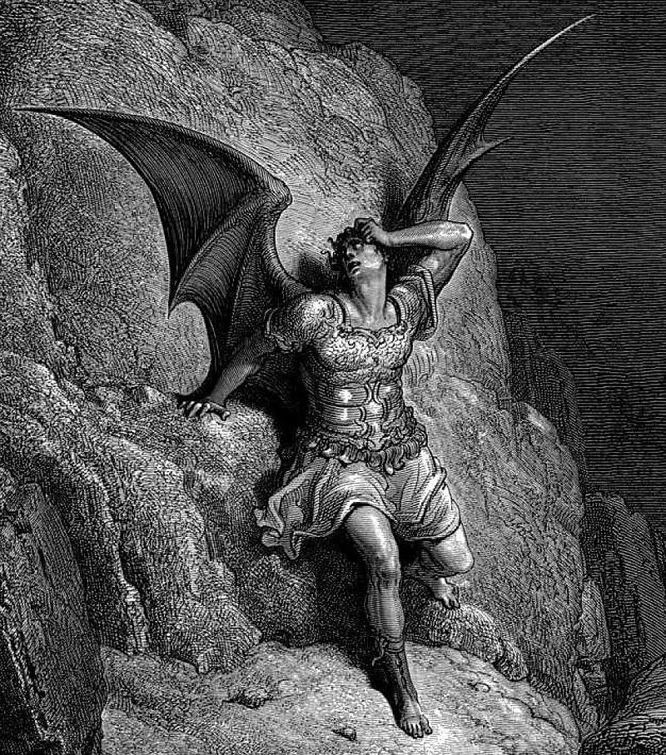

Line 1: include <iostream>
With so many error messages,
you may think you just
committed a cardinal sin…
Don’t despair: Often fixing the
first error will eliminate many
of the others
Baron Cohen as Borat
Gustave Doré, Lucifer

Slide 8
Line 1: inculde <iostream>
The error message:
  example.cpp:1:2: error: invalid preprocessing directive #inculde
  #inculde <iostream>
  ^
  example.cpp: In function 'int main()':
  example.cpp:7:5: error: 'cout' is not a member of 'std'
  std::cout << "Hello world!" << std::endl;
  ^
  example.cpp:7:36: error: 'endl' is not a member of 'std'
  std::cout << "Hello world!" << std::endl;
  ^
  example.cpp:8:5: error: 'cout' is not a member of 'std'
  std::cout << "sin(0.5) = " << my_sin(0.5) << "!" << std::endl;
  ^
  example.cpp:8:57: error: 'endl' is not a member of 'std'
  std::cout << "sin(0.5) = " << my_sin(0.5) << "!" << std::endl;
  ^
Again, look at the first error message first
  The compiler does not recognize #inculde as a preprocessing directive

Slide 9
Line 1: #include iostream>
The error message:
  example.cpp:1:11: error: #include expects "FILENAME" or <FILENAME>
  #include iostream>
  ^
  example.cpp: In function 'int main()':
  example.cpp:7:5: error: 'cout' is not a member of 'std'
  std::cout << "Hello world!" << std::endl;
  ^
  example.cpp:7:36: error: 'endl' is not a member of 'std'
  std::cout << "Hello world!" << std::endl;
  ^
  example.cpp:8:5: error: 'cout' is not a member of 'std'
  std::cout << "sin(0.5) = " << my_sin(0.5) << "!" << std::endl;
  ^
  example.cpp:8:57: error: 'endl' is not a member of 'std'
  std::cout << "sin(0.5) = " << my_sin(0.5) << "!" << std::endl;
  ^
The included file must be started with either a " or a <

Slide 10
Line 1: #include <iostraem>
The error message:
  example.cpp:1:20: fatal error: iostraem: No such file or directory
  #include <iostraem>
  ^
If the file cannot be found, chances are it is misspelled

Slide 11
Line 1: #include <iostreamx
The error message:
  example.cpp:1:19: error: missing terminating > character
  #include <iostream
  ^
The error message here is very clear

Slide 12
Line 4: integer main();x
Suppose you forget that the type is int, and instead use integer
    // Function declarations
    integer main();
    double my_sin( double x );
The error message is clear, too:
  example.cpp:4:1: error: 'integer' does not name a type
  integer main();
  ^
In example.cpp, on line 4
starting at column 1…

Slide 13
Line 4: int Main();x
Some programming languages use Main: suppose you forgot you were using C++:
    // Function declarations
    int Main();
    double my_sin( double x );
    // Function definitions
    int Main() {
    …
The error message is initially unclear, but the point is made:
  /usr/lib/gcc/x86_64-redhat-linux/4.8.5/../../../../lib64/crt1.o: In function '_start':
  (.text+0x20): undefined reference to 'main'
  collect2: error: ld returned 1 exit status
Our function int Main() is a perfectly good function
  It’s just not the one that C++ executes when launching a program

Slide 14
Line 5: double my_sin(…)x
Suppose you forgot the semicolon after the function declaration:
    // Function declarations
    int main();
    double my_sin( double x )
    // Function definitions
    int main() {
    …
The error message is less clear:
  example.cpp:8:1: error: expected initializer before 'int'
  int main() {
  ^
It’s trying to understand:
    double my_sin( double x ) int main() { …

Slide 15
Line 9 & 10: cout << …x
Suppose you forget the namespace std::
    cout << "Hello world!" << endl;
    cout << "sin(0.5) = " << mysin(0.5) << "!" << endl;
The compiler makes suggestions:
  example.cpp: In function 'int main()':
  example.cpp:9:5: error: 'cout' was not declared in this scope
  cout << "Hello world!" << endl;
  ^
  example.cpp:9:5: note: suggested alternative:
  In file included from example.cpp:1:0:
  /usr/include/c++/4.8.2/iostream:61:18: note: 'std::cout'
  extern ostream cout; /// Linked to standard output
  ^
  example.cpp:9:31: error: 'endl' was not declared in this scope
  cout << "Hello world!" << endl;
  ^
  example.cpp:9:31: note: suggested alternative:
  In file included from /usr/include/c++/4.8.2/iostream:39:0,
  from example.cpp:1:
  /usr/include/c++/4.8.2/ostream:564:5: note: 'std::endl'
  endl(basic_ostream<_CharT, _Traits>& __os)
  ^
Like we include iostream,
iostream includes ostream

Slide 16
Line 9: no opening quote
Suppose you forgot an opening quote:
    std::cout << Hello world!" << std::endl;
The error message is somewhat complicated:
  example.cpp:9:30: warning: missing terminating " character [enabled by default]
  std::cout << Hello world!" << std::endl;
  ^
  example.cpp:9:5: error: missing terminating " character
  std::cout << Hello world!" << std::endl;
  ^
  example.cpp: In function 'int main()':
  example.cpp:9:18: error: 'Hello' was not declared in this scope
  std::cout << Hello world!" << std::endl;
  ^
  example.cpp:9:24: error: expected ';' before 'world'
  std::cout << Hello world!" << std::endl;
  ^

Slide 17
Line 9: no closing quote
Suppose you forgot a closing quote:
    std::cout << "Hello world! << std::endl;
The error message is straight-forward:
  example.cpp:9:18: warning: missing terminating " character [enabled by default]
  std::cout << "Hello world! << std::endl;
  ^
  example.cpp:9:5: error: missing terminating " character
  std::cout << "Hello world! << std::endl;
  ^

Slide 18
Line 10: no closing quote
Suppose you forgot a different closing quote:
    std::cout << "sin(0.5) = << my_sin(0.5) << "!" << std::endl;
The error message is somewhat confusing:
  example.cpp:10:51: warning: missing terminating " character [enabled by default]
  std::cout << "sin(0.5) = << my_sin(0.5) << "!" << std::endl;
  ^
  example.cpp:10:5: error: missing terminating " character
  std::cout << "sin(0.5) = << my_sin(0.5) << "!" << std::endl;
  ^
  example.cpp: In function 'int main()':
  example.cpp:10:50: error: expected ';' before '!' token
  std::cout << "sin(0.5) = << my_sin(0.5) << "!" << std::endl;
The last message recognizes ! as a unary operator
  For this line to make any sense, the previous statement must end before the ! operator
  std::cout << "sin(0.5) = << my_sin(0.5) << ";
  !" << std::endl;

Slide 19
Line 10: misspelled identifiers
Suppose you misspelled the function identifier my_sin:
    std::cout << "sin(0.5) = " << mysin(0.5) << "!" << std::endl;
The error message is less clear:
  example.cpp: In function 'int main()':
  example.cpp:10:44: error: 'mysin' was not declared in this scope
  std::cout << "sin(0.5) = " << mysin(0.5) << "!" << std::endl;
  ^
The issue is clear: the compiler does not know what mysin is…

Slide 20
Line 15: unmatched definition
Suppose the function declaration and definition don’t match in the return type:
    int my_sin( double x ) {
The error message points out the ambiguity:
  example.cpp: In function 'int my_sin(double)':
  example.cpp:15:22: error: new declaration 'int my_sin(double)'
  int my_sin( double x ) {
  ^
  example.cpp:5:8: error: ambiguates old declaration 'double my_sin(double)'
  double my_sin( double x );
  ^
The return types of the function declaration and definition must match

Slide 21
Line 15: unmatched definition
Suppose function declaration and definition don’t match in the parameter types:
    double my_sin( int x ) {
The error message points out the ambiguity:
  /tmp/cc46i29P.o: In function `main':
  example.cpp:(.text+0x39): undefined reference to 'my_sin(double)'
  collect2: error: ld returned 1 exit status
It was fine with you defining a my_sin taking an int, but it’s looking for a my_sin taking a double

Slide 22
Line 16: invalid comments
Suppose you accidentally used / for a comment:
    / This uses a Taylor series approximation of sin(x)
The error message is less clear:
  example.cpp: In function 'double my_sin(double)':
  example.cpp:16:5: error: expected primary-expression before '/' token
  / This uses a Taylor series approximation of sin(x)
  ^
  example.cpp:16:7: error: 'This' was not declared in this scope
  / This uses a Taylor series approximation of sin(x)
  ^
  example.cpp:16:12: error: expected ';' before 'uses'
  / This uses a Taylor series approximation of sin(x)
  ^
The compiler is interpreting the / as a division sign
  As division is a binary operator, it needs a left operand

Slide 23
Line 17: unmatched opening parenthesis
Suppose you forget a closing parenthesis:
    return ((-0.00019841269841269841*x*x
    + 0.0083333333333333333 *x*x
    - 0.16666666666666667)*x*x + 1.0;
Its suggesting you add a closing parenthesis, but in the wrong location:
  example.cpp: In function 'double my_sin(double)':
  example.cpp:19:45: error: expected ')' before ';' token
  - 0.16666666666666667)*x*x + 1.0;
  ^

Slide 24
Line 17: unmatched closing parenthesis
Suppose you forgot an opening parenthesis:
    return (-0.00019841269841269841*x*x
    + 0.0083333333333333333)*x*x
    - 0.16666666666666667)*x*x + 1.0;
The error message suggests the statement ends after the 7:
  example.cpp: In function 'double my_sin(double)':
  example.cpp:19:34: error: expected ';' before ')' token
  - 0.16666666666666667)*x*x + 1.0;
  ^
  example.cpp:19:34: error: expected primary-expression before ')' token
  example.cpp:19:34: error: expected ';' before ')' token
The suggestion is wrong, but the compiler doesn’t know your intentions

Slide 25
Line 17: unknown identifiers
Suppose you forgot the * with juxtaposition:
    return ((-0.00019841269841269841*xx
    + 0.0083333333333333333)*x*x
    - 0.16666666666666667)*x*x + 1.0;
The error message says nothing about the missing *; instead:
  example.cpp: In function 'double my_sin(double)':
  example.cpp:17:38: error: 'xx' was not declared in this scope
  return ((-0.00019841269841269841*xx
  ^
Its just saying: “I have no clue what 'xx' is…”

Slide 26
Line 17: space for multiplication
Suppose you forgot the * and used a space:
    return ((-0.00019841269841269841*x x
    + 0.0083333333333333333)*x*x
    - 0.16666666666666667)*x*x + 1.0;
The error message is a little unhelpful:
  example.cpp: In function 'double my_sin(double)':
  example.cpp:17:40: error: expected ')' before 'x'
  return ((-0.00019841269841269841*x x
  ^
  example.cpp:19:45: error: expected ')' before ';' token
  - 0.16666666666666667)*x*x + 1.0;
  ^
It suggests there should be a closing parenthesis after the first 'x'
  After this, the second error message is confusing

Slide 27
Line 17: unmatched braces
Students often forget to close braces at the end of functions:
The error message is very clear:
  example.cpp: In function 'double my_sin(double)':
  example.cpp:19:45: error: expected '}' at end of input
  - 0.16666666666666667)*x*x + 1.0;
  ^
It’s suggesting you put the closing brace at the end of the line
  The start of the next line is fine
double my_sin( double x ) {
// This uses a Taylor series approximation of sin(x)
return ((-0.00019841269841269841*x*x
+ 0.0083333333333333333)*x*x
- 0.16666666666666667)*x*x + 1.0; }

Slide 28
Summary
Following this lesson, you now:
  Understand that some mistakes lead to code that cannot be compiled
  Understand the compiler makes attempts to point out where the issue is
    It may be wrong…
  Know to always try to fix the first compile-time error first
    That may fix subsequent errors

Slide 29
References
[1] Wikipedia
https://en.wikipedia.org/wiki/Compilation_error
[2] cplusplus.com: list of preprocessing directives
http://www.cplusplus.com/doc/tutorial/preprocessor/

Slide 30
Acknowledgments
Proof read by Dr. Thomas McConkey

Slide 31



Colophon
These slides were prepared using the Georgia typeface. Mathematical equations use Times New Roman, and source code is presented using Consolas.
The photographs of lilacs in bloom appearing on the title slide and accenting the top of each other slide were taken at the Royal Botanical Gardens on May 27, 2018 by Douglas Wilhelm Harder. Please see
https://www.rbg.ca/
for more information.

Slide 32
Disclaimer
These slides are provided for the ece 150 Fundamentals of Programming course taught at the University of Waterloo. The material in it reflects the authors’ best judgment in light of the information available to them at the time of preparation. Any reliance on these course slides by any party for any other purpose are the responsibility of such parties. The authors accept no responsibility for damages, if any, suffered by any party as a result of decisions made or actions based on these course slides for any other purpose than that for which it was intended.

